Slide 1
Online Class Maintenance System
Presented by
Syed Mahfuzur Rahman
Minhaz Sharif Akash

Slide 2
Introduction
Online class maintenance system help student as well as teacher to keep track of the class but also have a feature that make it easy to get the attendance from the students. It includes a personal profile login system, that give access to the features. It also has an easy to registration system. Teacher can store the attendance data on database. Software has a admin panel from there a admin can make changes to the existing database but do not have permission to edit the attendance system.

Slide 3
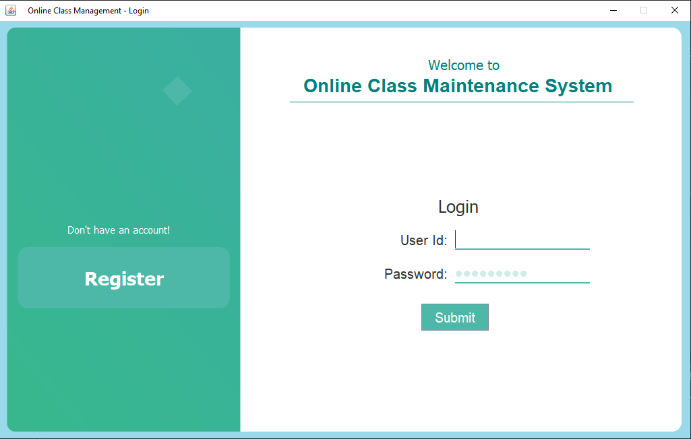
Login Page Login page is the first page of our program. User must have to provide login information to get access to the next page. In case user first time using this program, he/she can register by clicking ‘Register’ button.
Login Info
ID
Password
Press to login

Slide 4
Login Page Login page is the first page of our program. User must have to provide login information to get access to the next page. In case user first time using this program, he/she can register by clicking ‘Register’ button.
Press this button to go into Registration page.

Slide 5
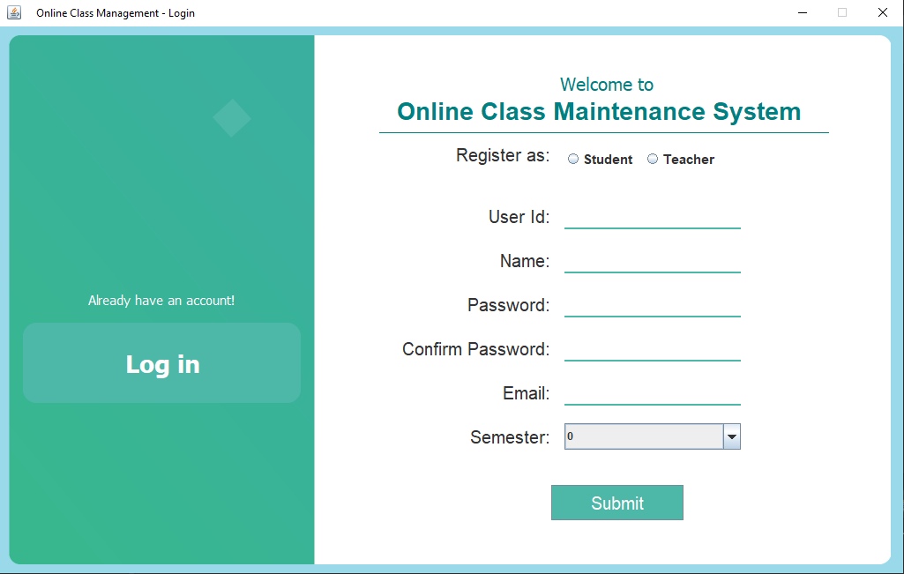
Registration Page Registration page is easy to use and Student/Teacher can register himself. Student have to use their id to register and Teacher have to use his/her phone number.
Have to fill all the box’s and press Submit

Slide 6
Registration Page Registration page is easy to use and Student/Teacher can register himself. Student have to use their id to register and Teacher have to use his/her phone number.
Already existing user can login by clicking this button, it takes user to the login page.

Slide 7
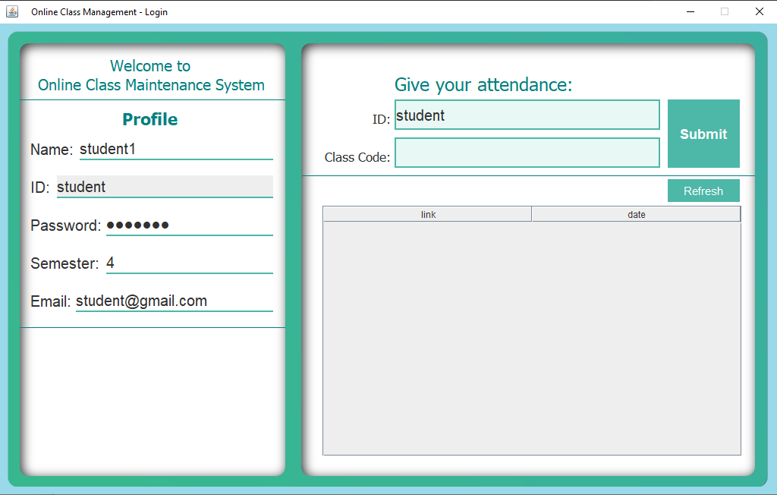
Student Login Student can login and see their profile Name, ID, Password, Sem, & Email. Student Panel have an attendance system that allow him/her to give attendance by the class code provided by their teacher. Also they can see the class link of the day provided by their teacher.
26Nov202027564
Student Profile

Slide 8
Student Login Student can login and see their profile Name, ID, Password, Sem, & Email. Student Panel have an attendance system that allow him/her to give attendance by the class code provided by their teacher. Also they can see the class link of the day provided by their teacher.
meet.google.com/our-pres-day | 26-11-2020+12.40.44
Class links will appear here

Slide 9
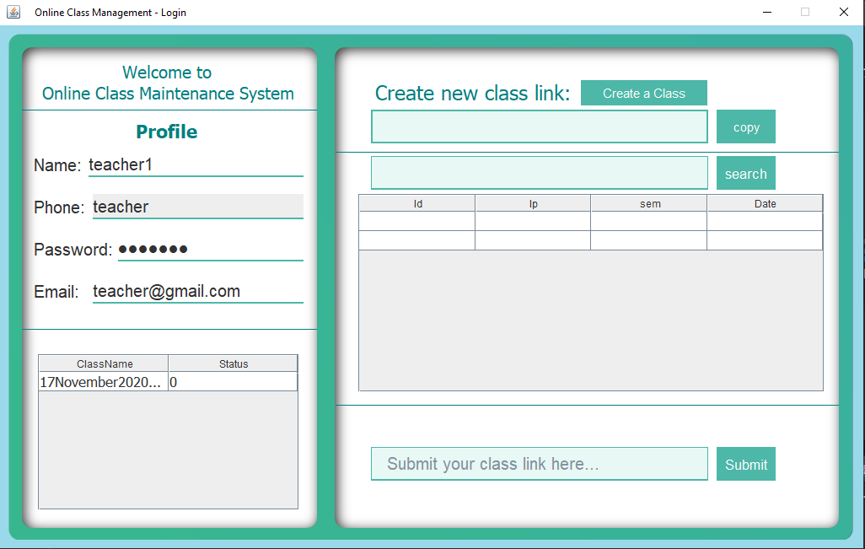
Teachers Login Teachers can login and see their profile Name, Phone, Password, & Email. Teachers Panel have a class code creating system that allow him/her to take attendance from his/her students by simply providing them the class code to give attendance. Also have a class search option. By using this opting previous class attendance list can be found. There is an option to submit class code before starting an online class. By this the link will be shared to the student and they can join the link.
User Details

Slide 10
Teachers Login Teachers can login and see their profile Name, Phone, Password, & Email. Teachers Panel have a class code creating system that allow him/her to take attendance from his/her students by simply providing them the class code to give attendance. Also have a class search option. By using this opting previous class attendance list can be found. There is an option to submit class code before starting an online class. By this the link will be shared to the student and they can join the link.
17November2020234

Slide 11
Teachers Login Teachers can login and see their profile Name, Phone, Password, & Email. Teachers Panel have a class code creating system that allow him/her to take attendance from his/her students by simply providing them the class code to give attendance. Also have a class search option. By using this opting previous class attendance list can be found. There is an option to submit class code before starting an online class. By this the link will be shared to the student and they can join the link.
17November2020234

Slide 12
Teachers Login Teachers can login and see their profile Name, Phone, Password, & Email. Teachers Panel have a class code creating system that allow him/her to take attendance from his/her students by simply providing them the class code to give attendance. Also have a class search option. By using this opting previous class attendance list can be found. There is an option to submit class code before starting an online class. By this the link will be shared to the student and they can join the link.
17November2020234
1182362 | 192.100… | 4 | 17-11-20..

Slide 13
Teachers Login Teachers can login and see their profile Name, Phone, Password, & Email. Teachers Panel have a class code creating system that allow him/her to take attendance from his/her students by simply providing them the class code to give attendance. Also have a class search option. By using this opting previous class attendance list can be found. There is an option to submit class code before starting an online class. By this the link will be shared to the student and they can join the link.
1182362 | 192.100… | 4 | 17-11-20..

Slide 14
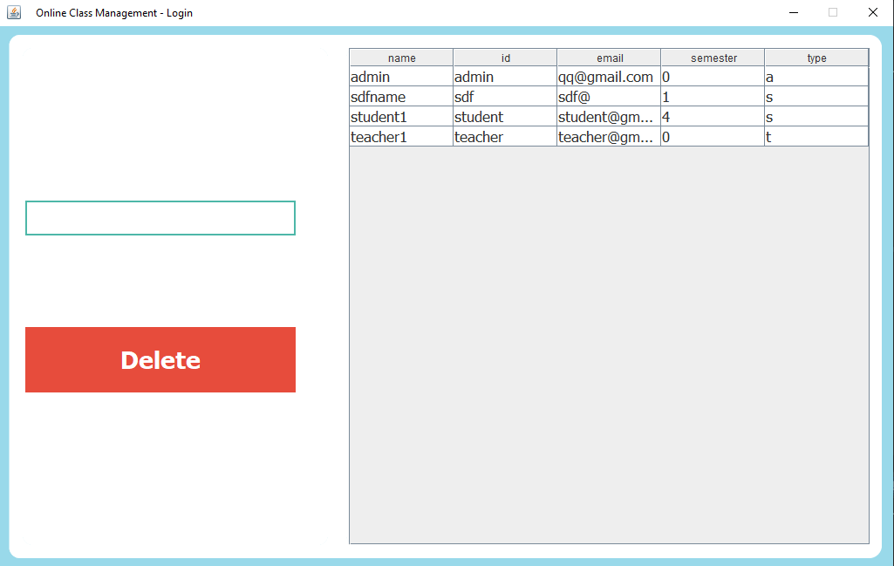
Admin Panel Admin panel can control the user. Admin have the power to delete any user information and restrict his/her access.
ID:
sdf

Slide 15
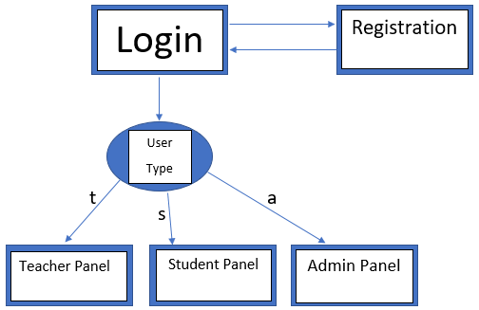
Program Diagram

Slide 16
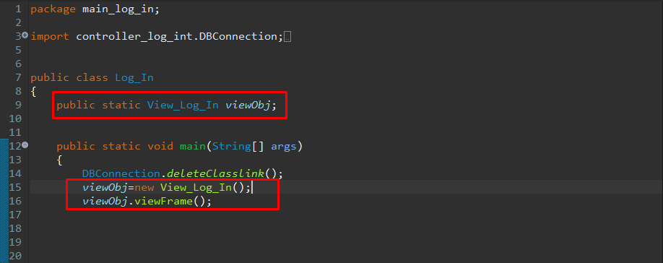
Here, object created of View_Log_In class as viewObj
Here a viewFrame() method called from viewObj

Slide 17
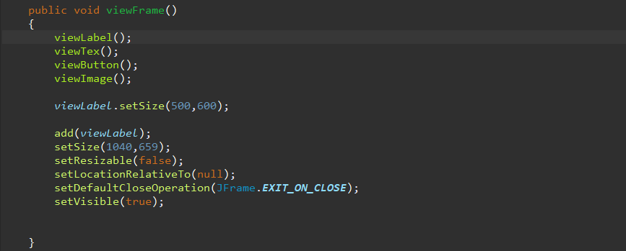
This viewFrame method that we called earlier from Object named viewObj

Slide 18
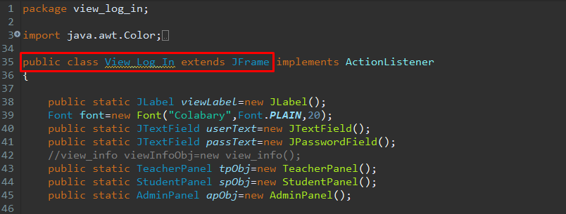
Here is an example of Inheritance.
In here View_Log_In class extends Jframe package that already exist in java swing
Inheritance

Slide 19
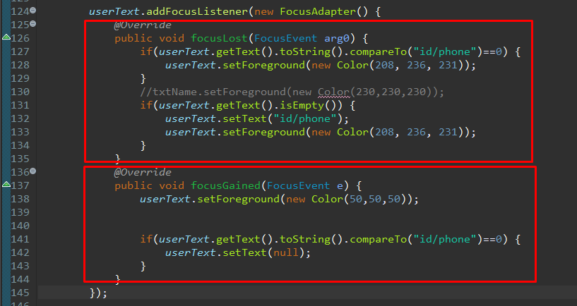
Here is a example of ActionListener overriding method.
Its overriding each other according to the action performed.
Override

Slide 20
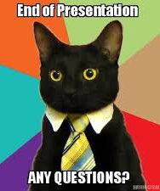
Thank You

